Slide 1
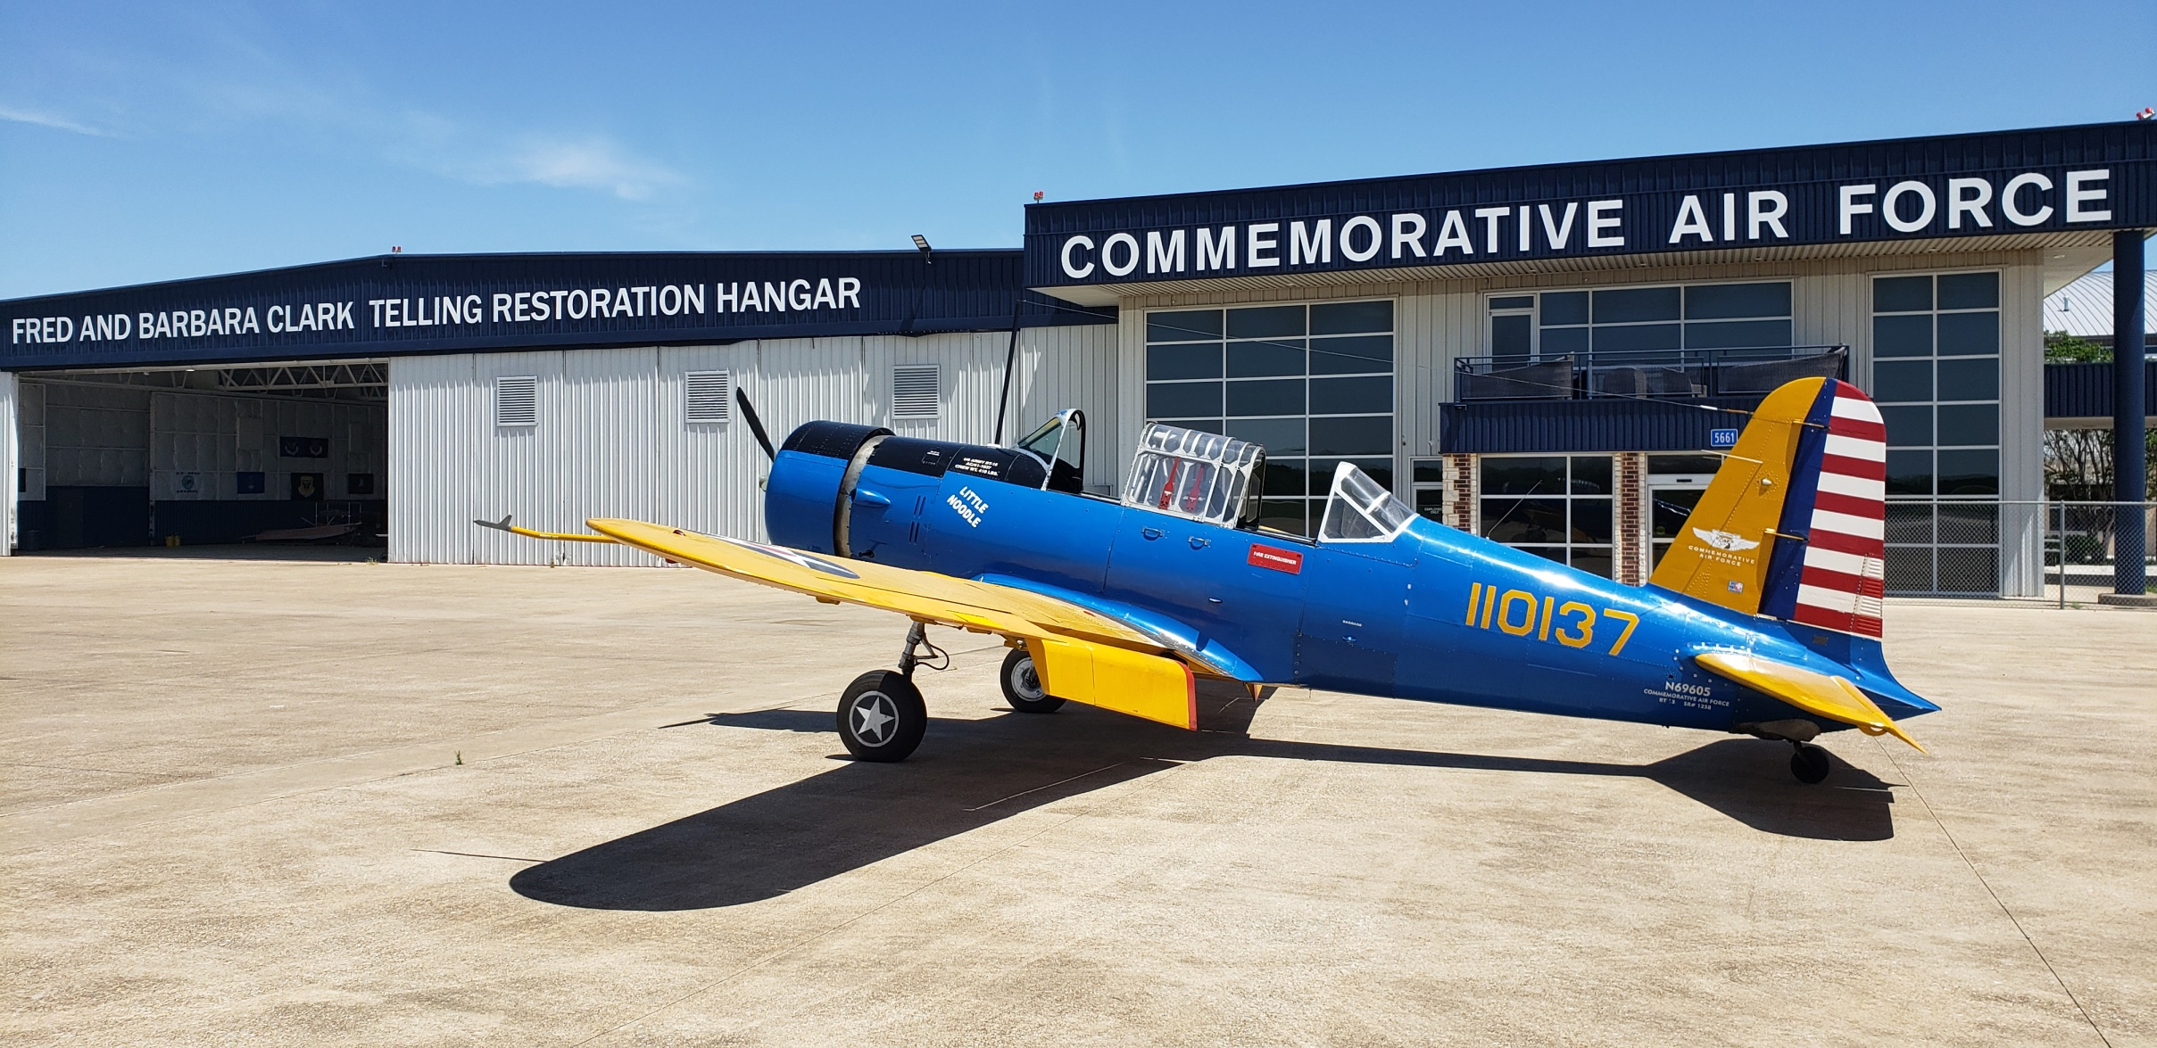
BT-15

Slide 2
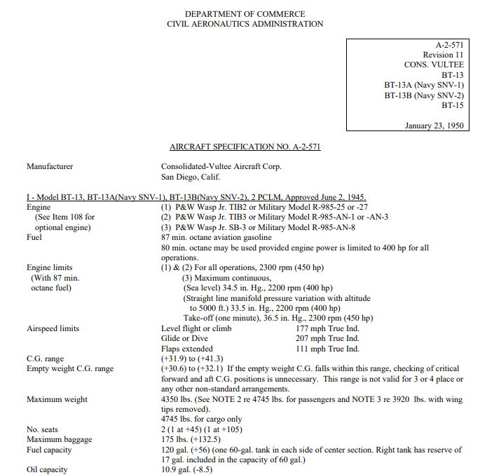
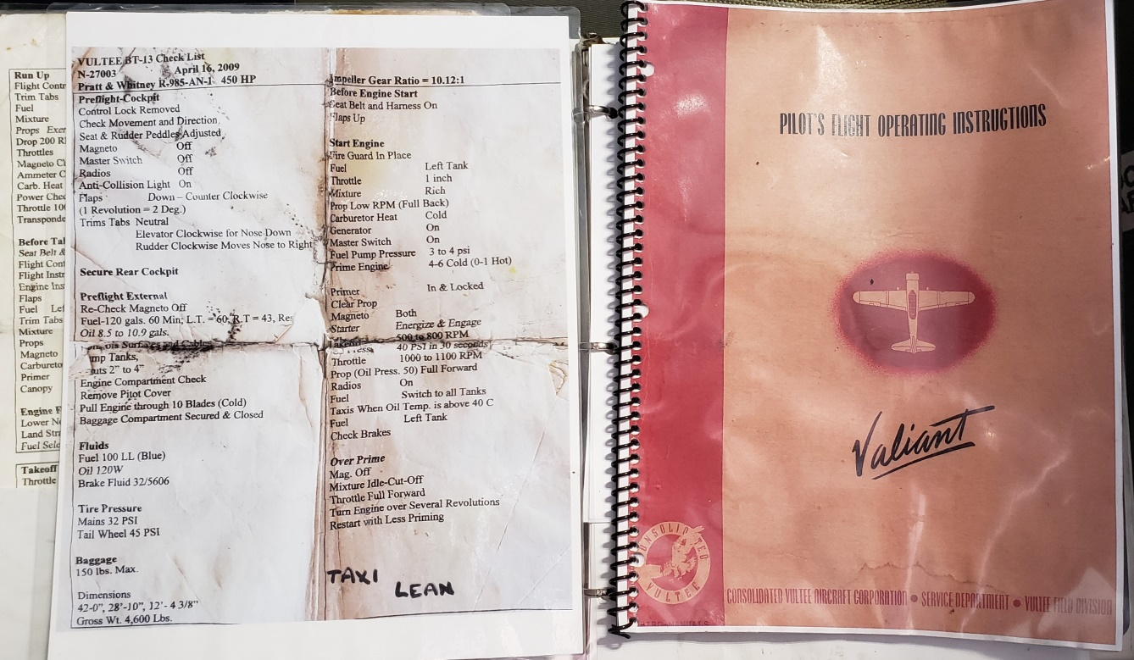

Slide 3
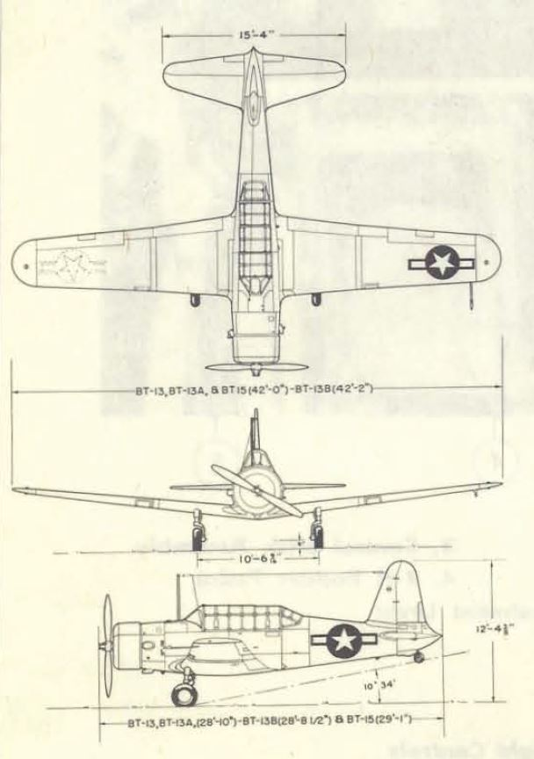

Slide 4
Vultee BT-15
General Characteristics
Crew: 2
Length: 29 ft 1 in
Wingspan: 42 ft 0 in
Height: 12 ft 4 3/8 in
Wing area: 239 sq ft
Empty weight: 3,305 lb
Max Gross weight: 4,350 lb
Powerplant: 1 × Wright R-975-11
nine-cylinder air-cooled radial engine, 440 hp
Performance
Range: 525 mi (1950 rpm, 27 gph, 10 gal TO, no reserve)
Service ceiling: 21,650 ft
4

Slide 5
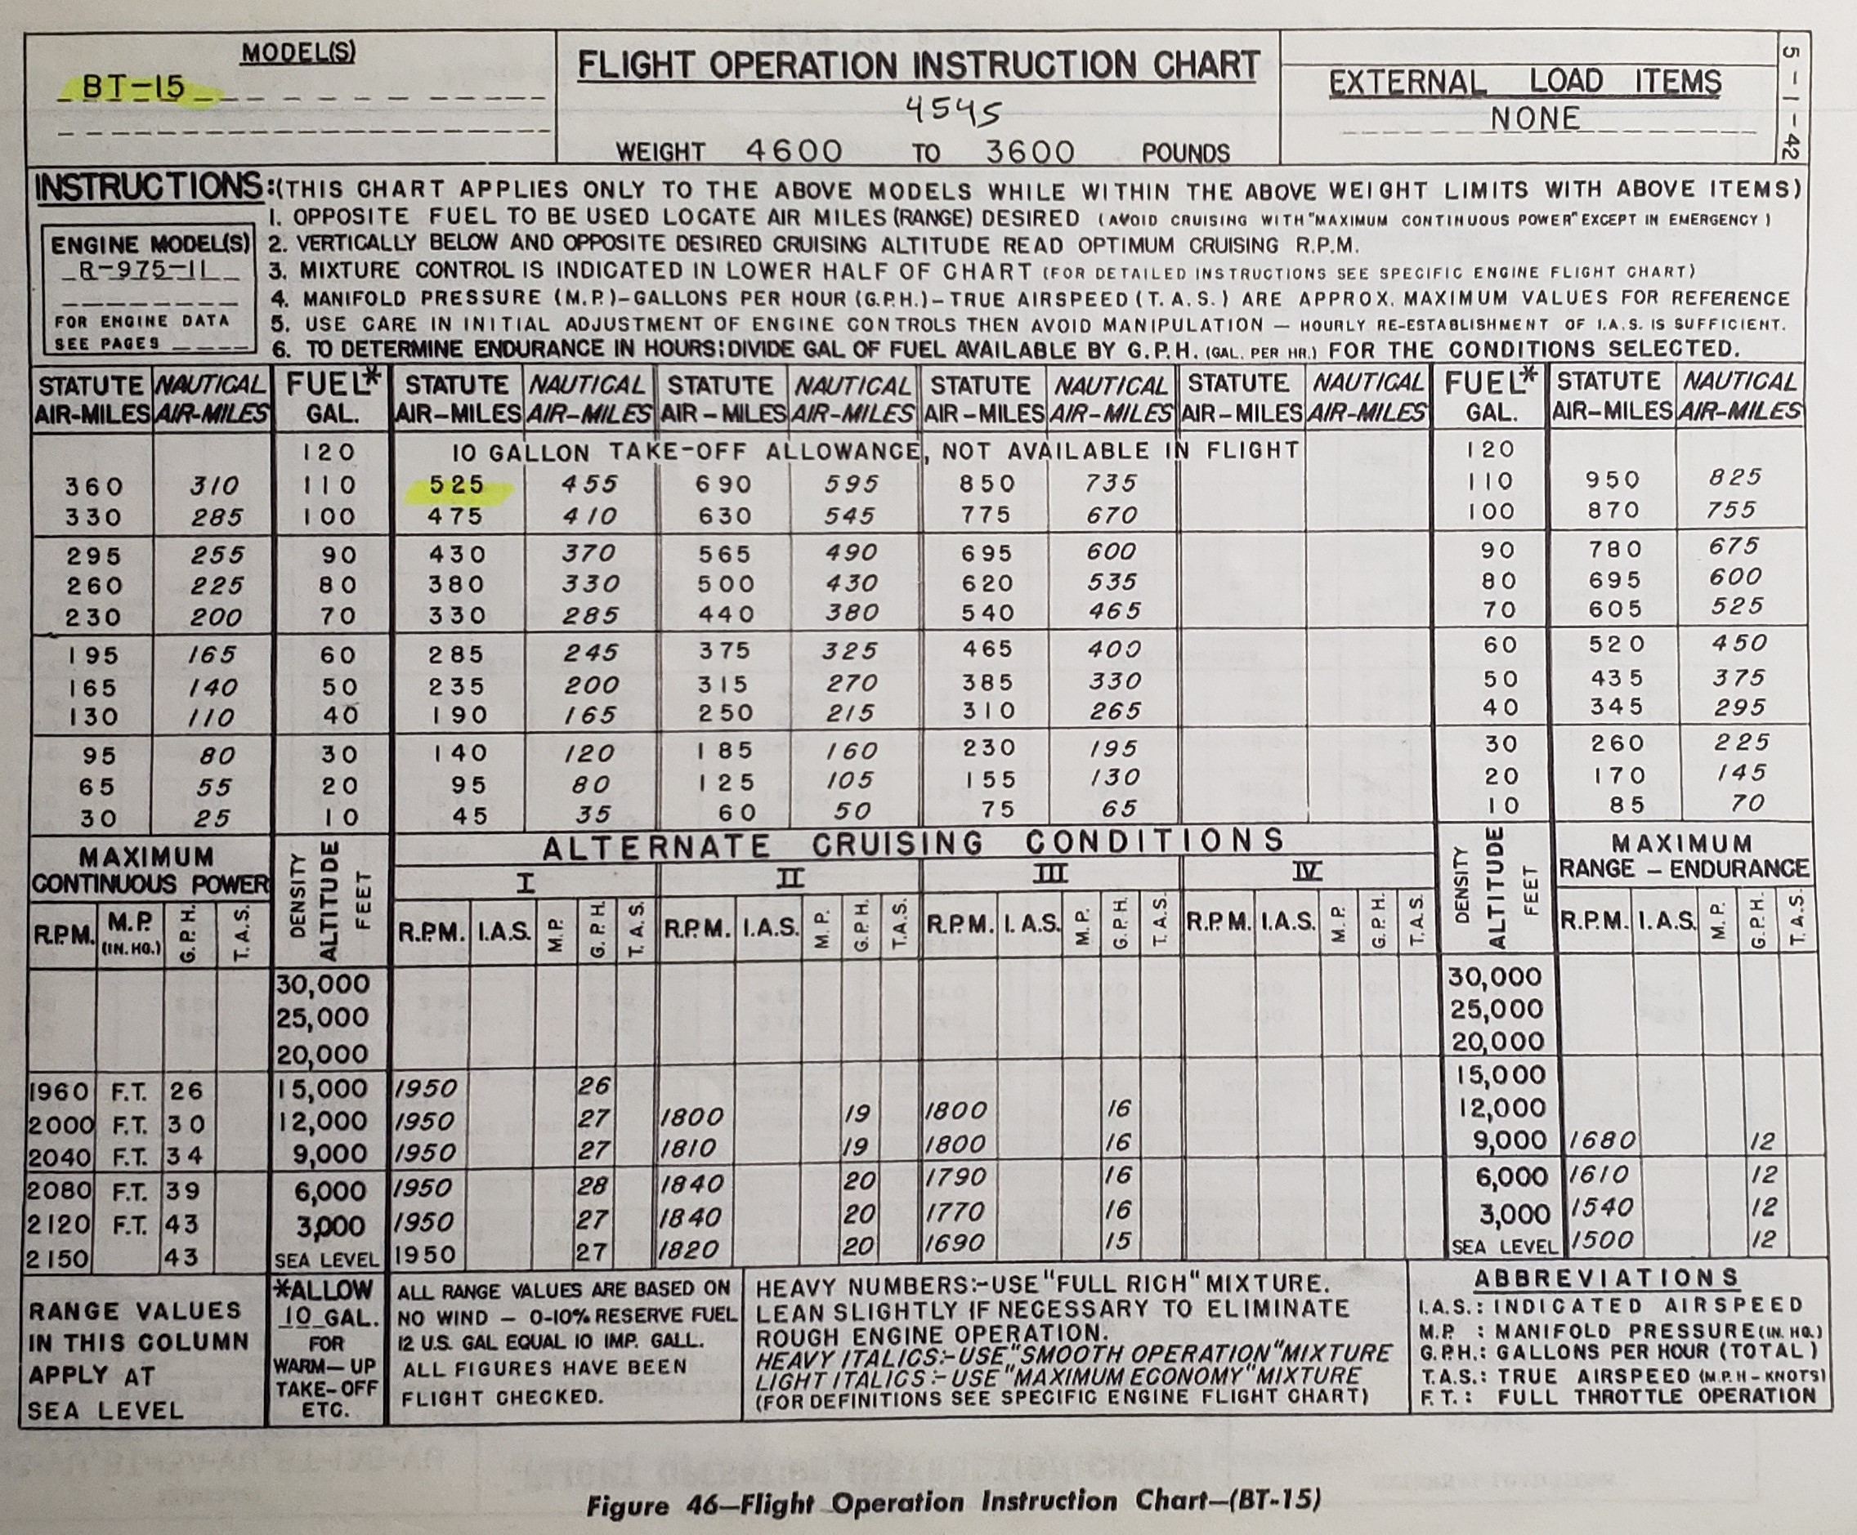

Slide 6
BT-15
General
Fuel: 60 gallons per side, 17 gallons of 60 is reserve on right side
Oil: 8.5 gallons (normal), 10.9 (overflow).
Normal Takeoff use 20º flaps
Climb at 90mph until flaps are retracted, then 100mph
Mag check 1700 rpm, max 100 drop
Field Baro Check at 2150 RPM
Maximum Baggage Capacity 175 pounds
6

Slide 7
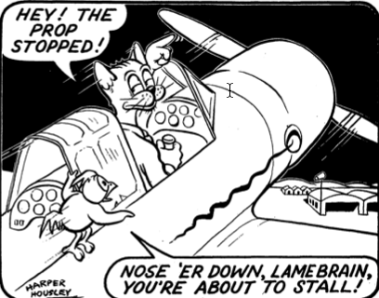
BT-15
Speeds
All in MPH
90 works for everything
Vy 90 with 20 flaps
Vy 100 with flaps up
Vne 207
Vno 177
Vfe 111
Vs 72
Vso 30 flap 65
Vso 60 flap 62
7

Slide 8
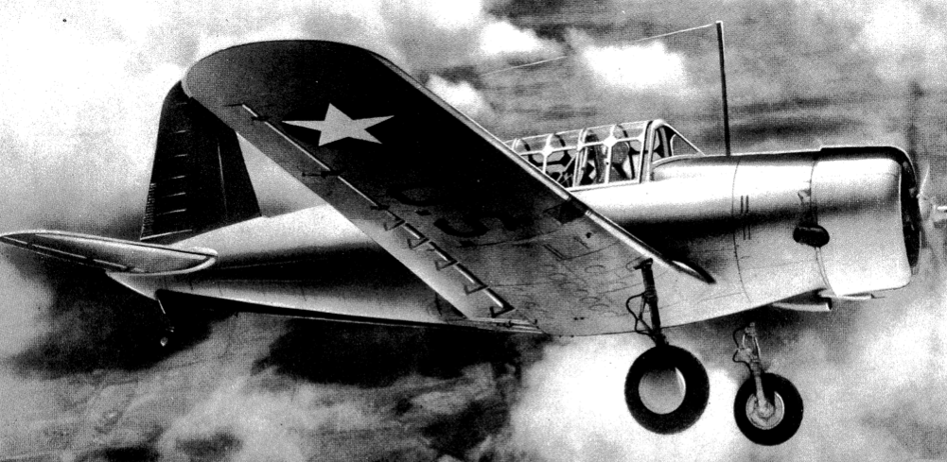
BT-15
Power Settings
Takeoff Full/2250 1minute
METO Full/2200 cont.
Climb 31/2100
Cruise 26/1900
8

Slide 9
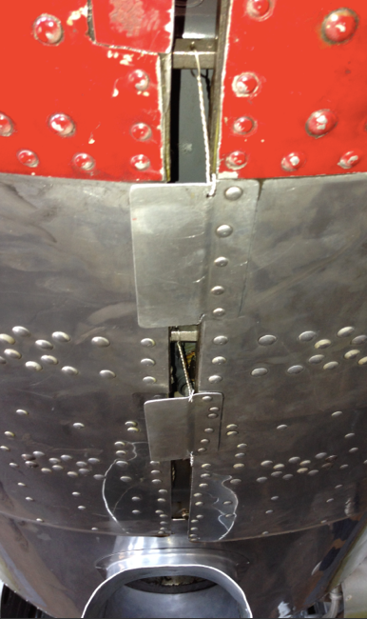
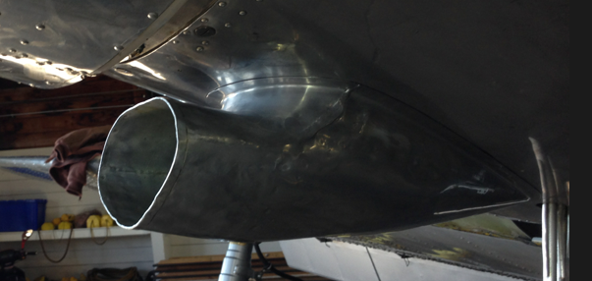
BT-15
Preflight
4 sumps, one under door.
Bottom intake is oil cooler.
Side intake is carb air inlet.
Make sure that all 3 wires are
secure in bottom of cowl.
9

Slide 10
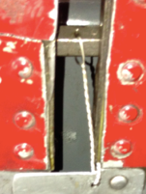
BT-15
Preflight
As with any radial engine the R-975 can retain oil in the cylinders if not flown for a period of time. Prop should be pulled through 7 blades to ensure all cylinders are cleared.
Cowling locking bolts and safety wire must be checked prior to flight.
10

Slide 11
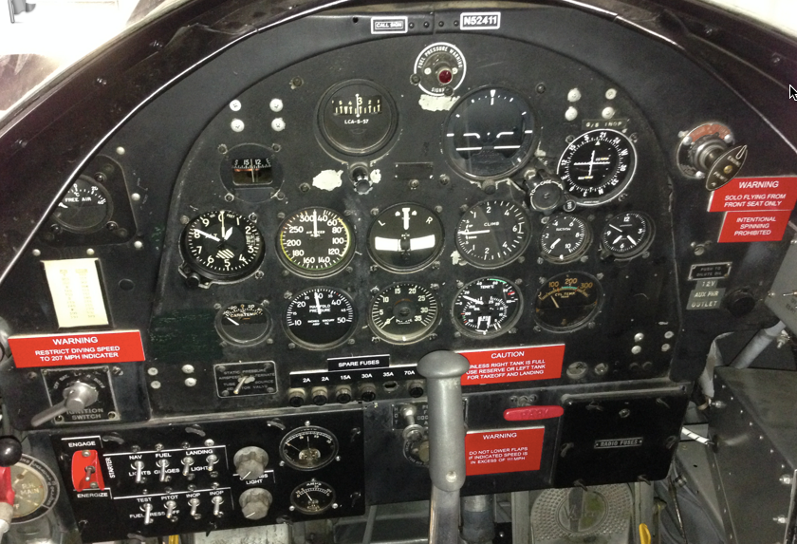
BT-15
Instruments
Both front and rear cockpits are equipped with the same instruments.
You cannot start the engine from the rear cockpit.
11

Slide 12
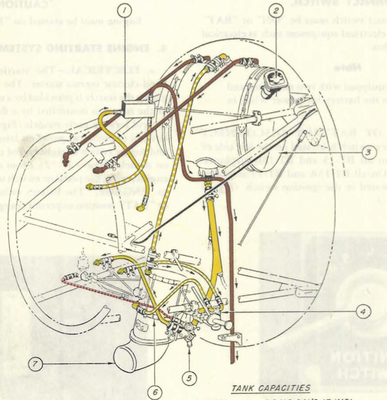
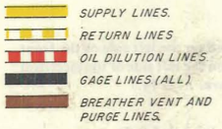
BT-15
Oil
The oil tank, located on the firewall, holds 10.9 gallons of oil. Normal operation is 8.5 gallons.
Aeroshell W120
12

Slide 13
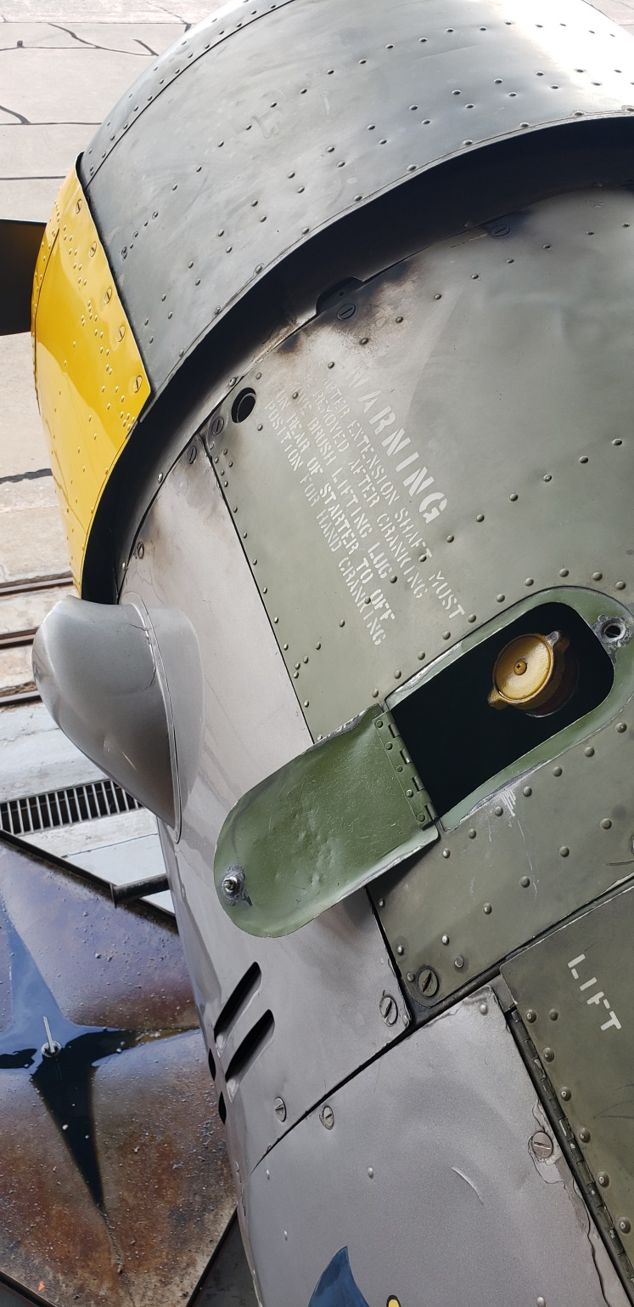
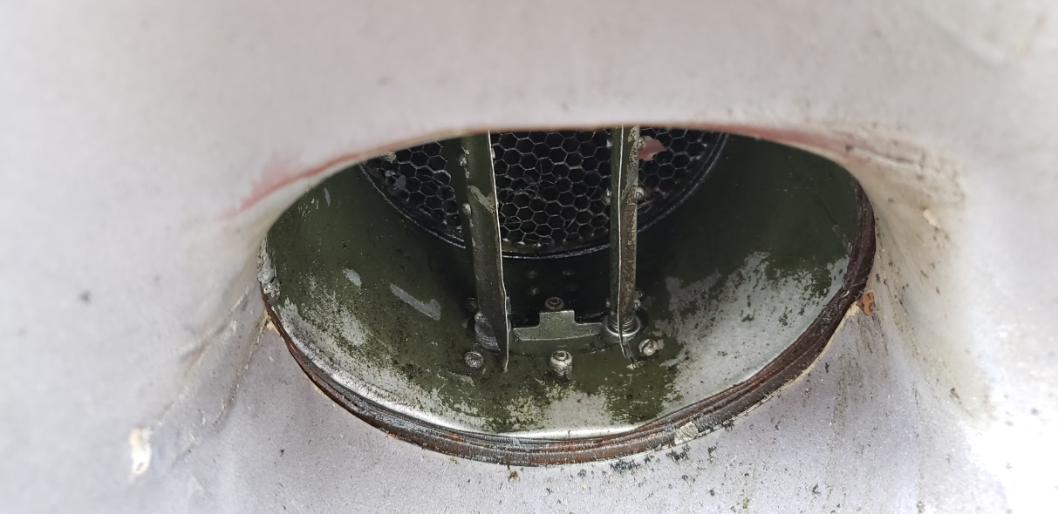

Slide 14
Select LEFT or RESERVE only!!

Slide 15
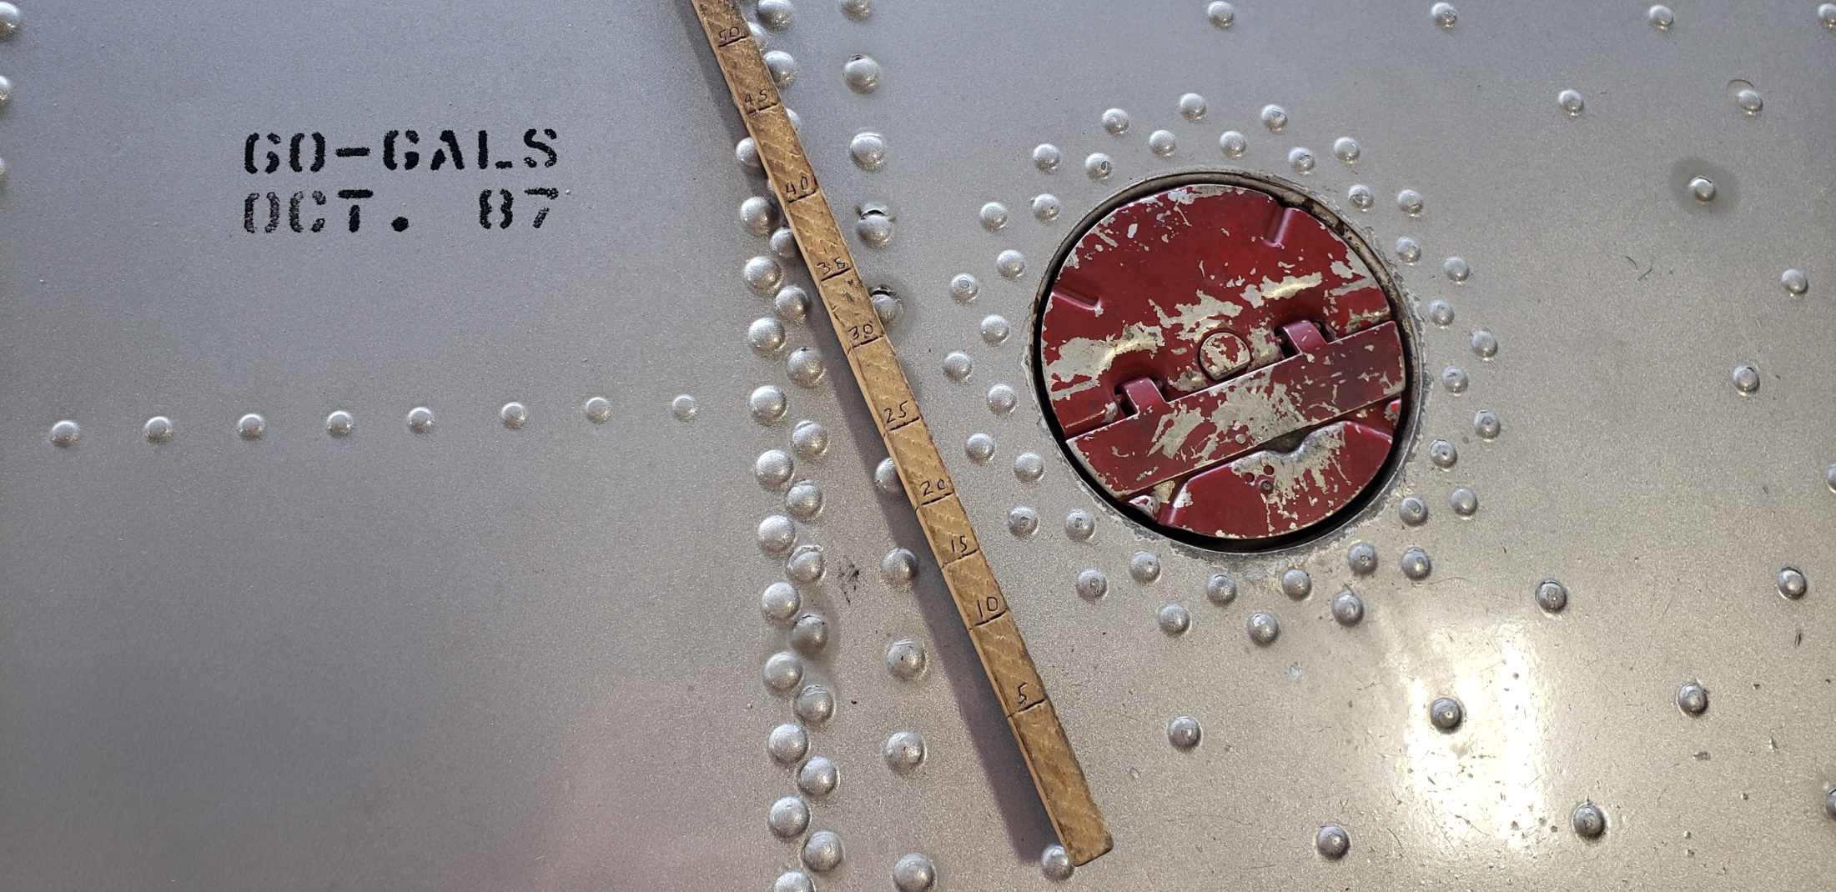

Slide 16
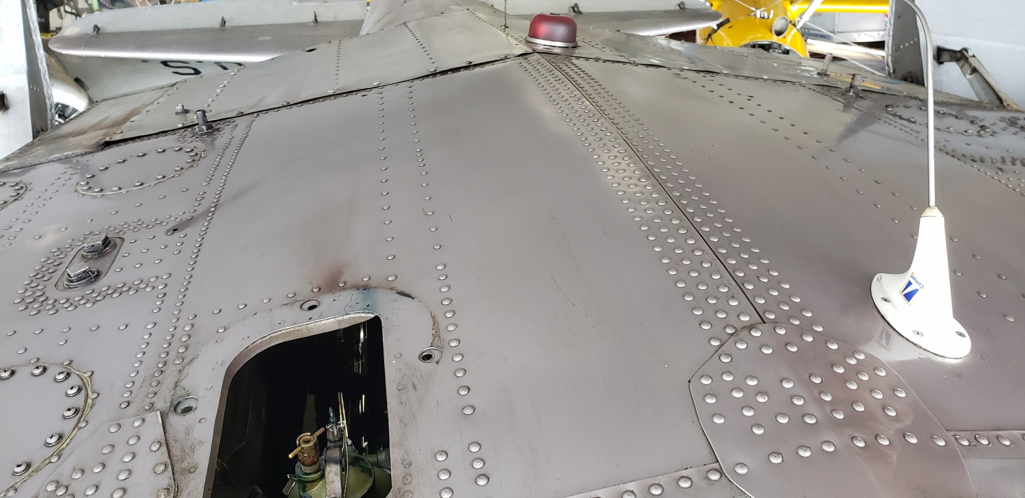

Slide 17
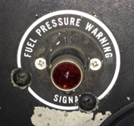
BT-13
Priming
Priming is accomplished by pumping the wobble (red handle) until the low fuel pressure light goes out. Then adding prime via the primer located in the upper right of the panel.
17

Slide 18
BT-15
Inertia Starter
The inertia starter is spooled up by holding the starter switch down to the Energize position.
* There is not a need to hold it for an extended period of time.
Start is accomplished by then moving the switch to the up position.
18

Slide 19
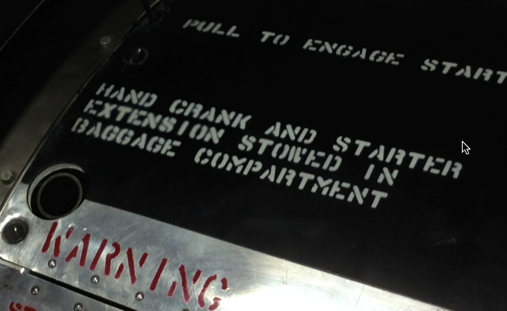
BT-15
Hand Start
The inertia starter can be turned by hand in the event battery power is not available. The crank, located in the baggage compartment, is inserted into the inlet.
Pilot MUST NOT engage starter until person cranking calls start.
19

Slide 20
BT-15
Flaps
Flap extension speed: 111 MPH
Extension at higher air speeds causes stress on the flap attach points. This can result leaking from the fuel tanks... Or worse.
20

Slide 21
BT-15
Flap Extension
Flaps are extended or retracted by turning the yellow crank. Each turn equals 2º of flap movement. May be operated from front or rear cockpit.
Make sure passengers are briefed that the spinning flap handle could hit their ankle if it is placed in the arc of the handle.
21

Slide 22
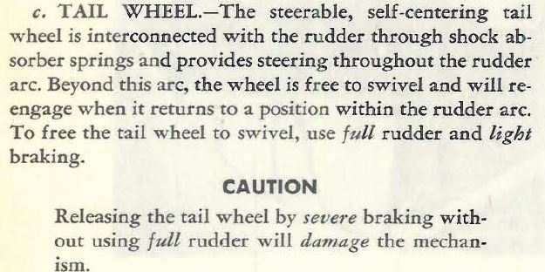
BT-15
Unlocking The Tail Wheel
22

Slide 23
BT-15
Canopy
Passengers should be briefed on the operation of the canopy. To open grasp the yellow handle and twist in either direction. Release to set lock pins.
Canopy can be in any position for any phase of flight.
23

Slide 24
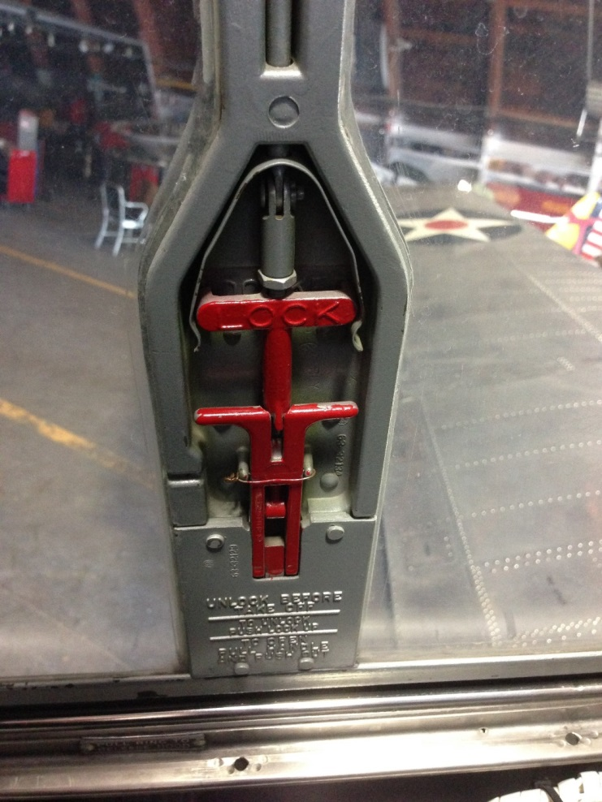
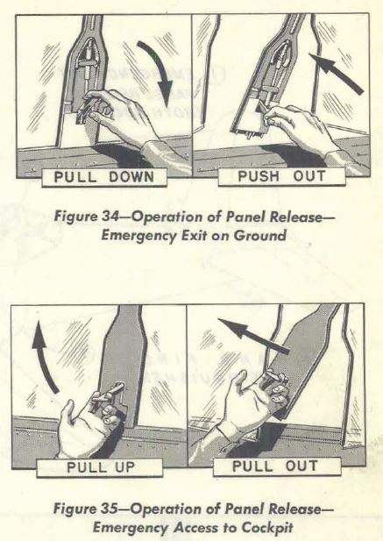
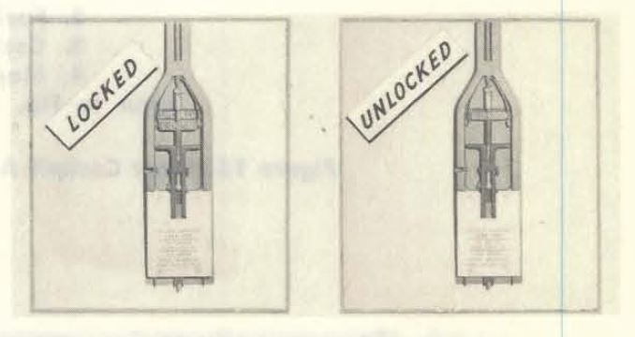
BT-15
Emergency Exit
Emergency panels are located in both front and rear canopies. Passengers should be briefed on the operation prior to flight.
24

Slide 25
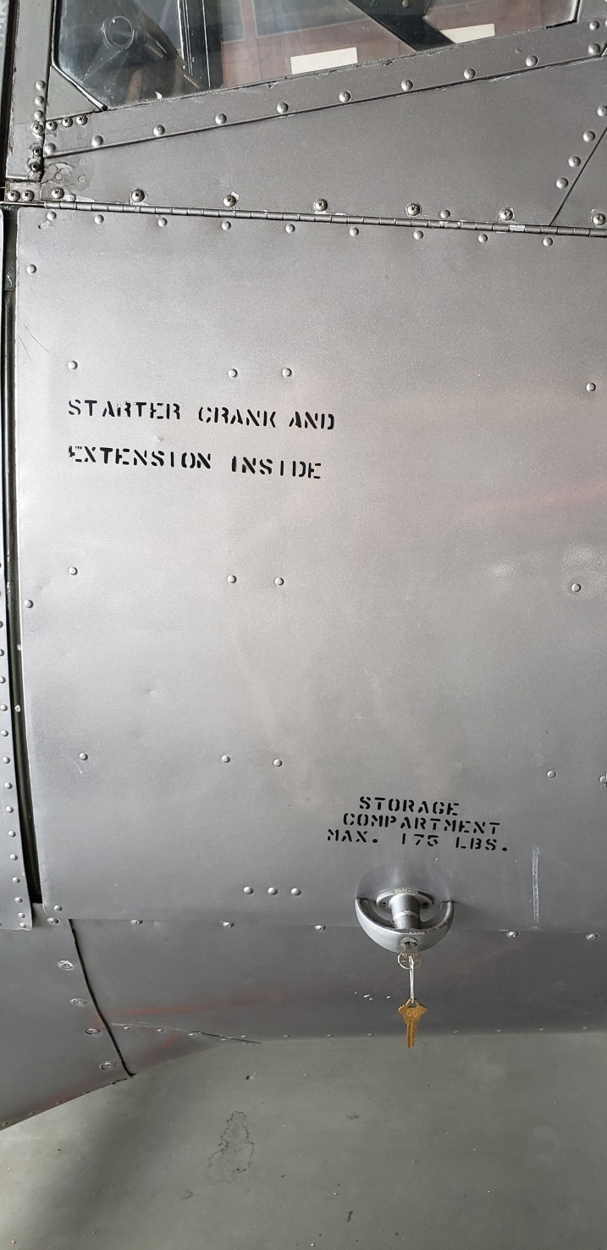
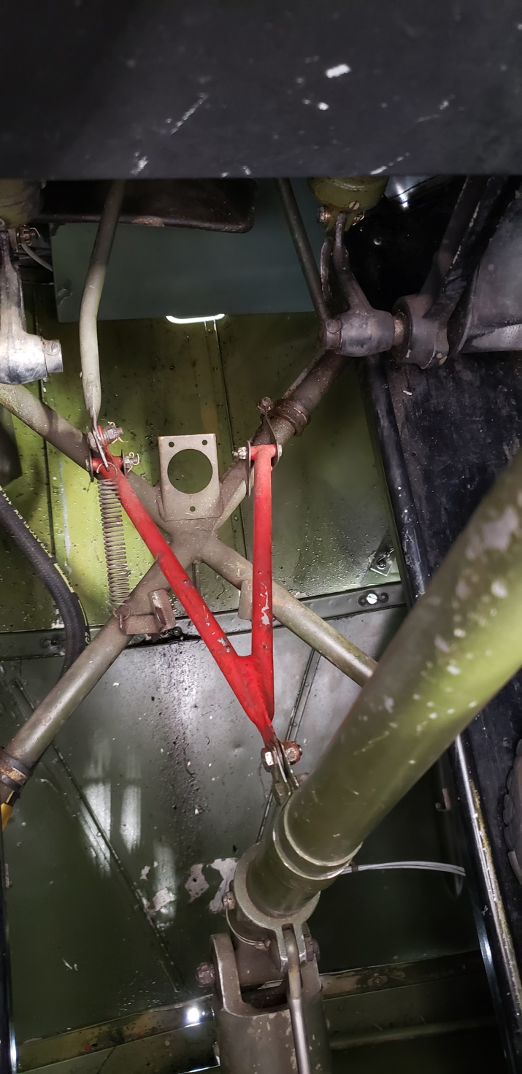

Slide 26
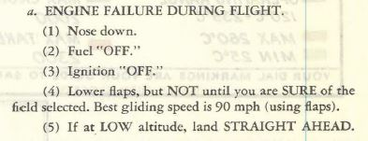

Slide 27
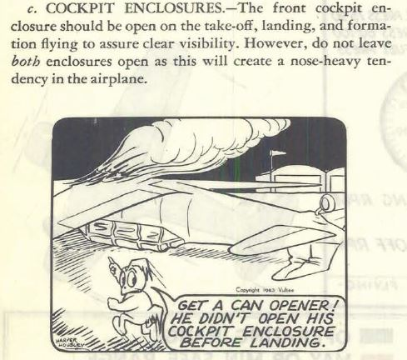
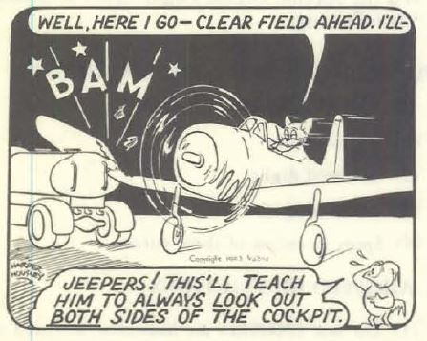

Slide 28
Engine fire during start
Keep cranking
Throttle open
Mixture/fuel off
Electrical fire
Avionics off
Alternator off
Master off
Electrical power failure
Conserve battery
Land
Go around
Mixture rich
Take off power
Trim
90 mph
Retract flaps >100’ AGL
100 mph

Slide 29
BT-15
System Questions
What is the fuel capacity?
What is the reserve fuel? Which tank?
What is the maximum flap extension speed?
How many degrees per turn does the flap handle move the flaps?
How is the tail wheel unlocked?
120 gallons
~17 gallons, Right
111 MPH
2º per turn
By turning the aircraft beyond the normal turning arc.
29

Slide 30
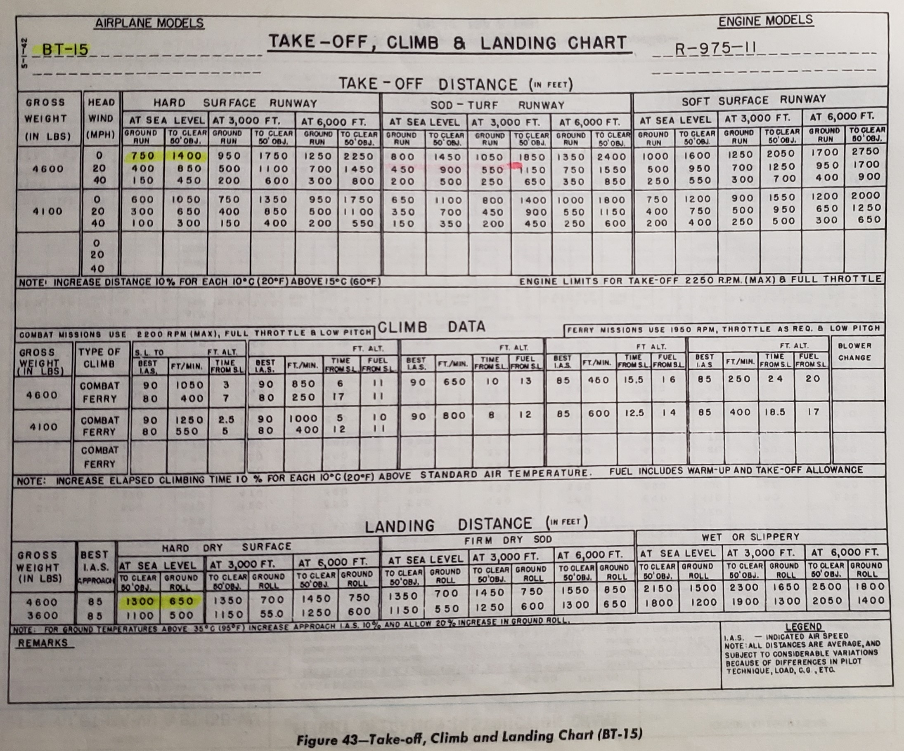
{ }
-----------------------------

Slide 31
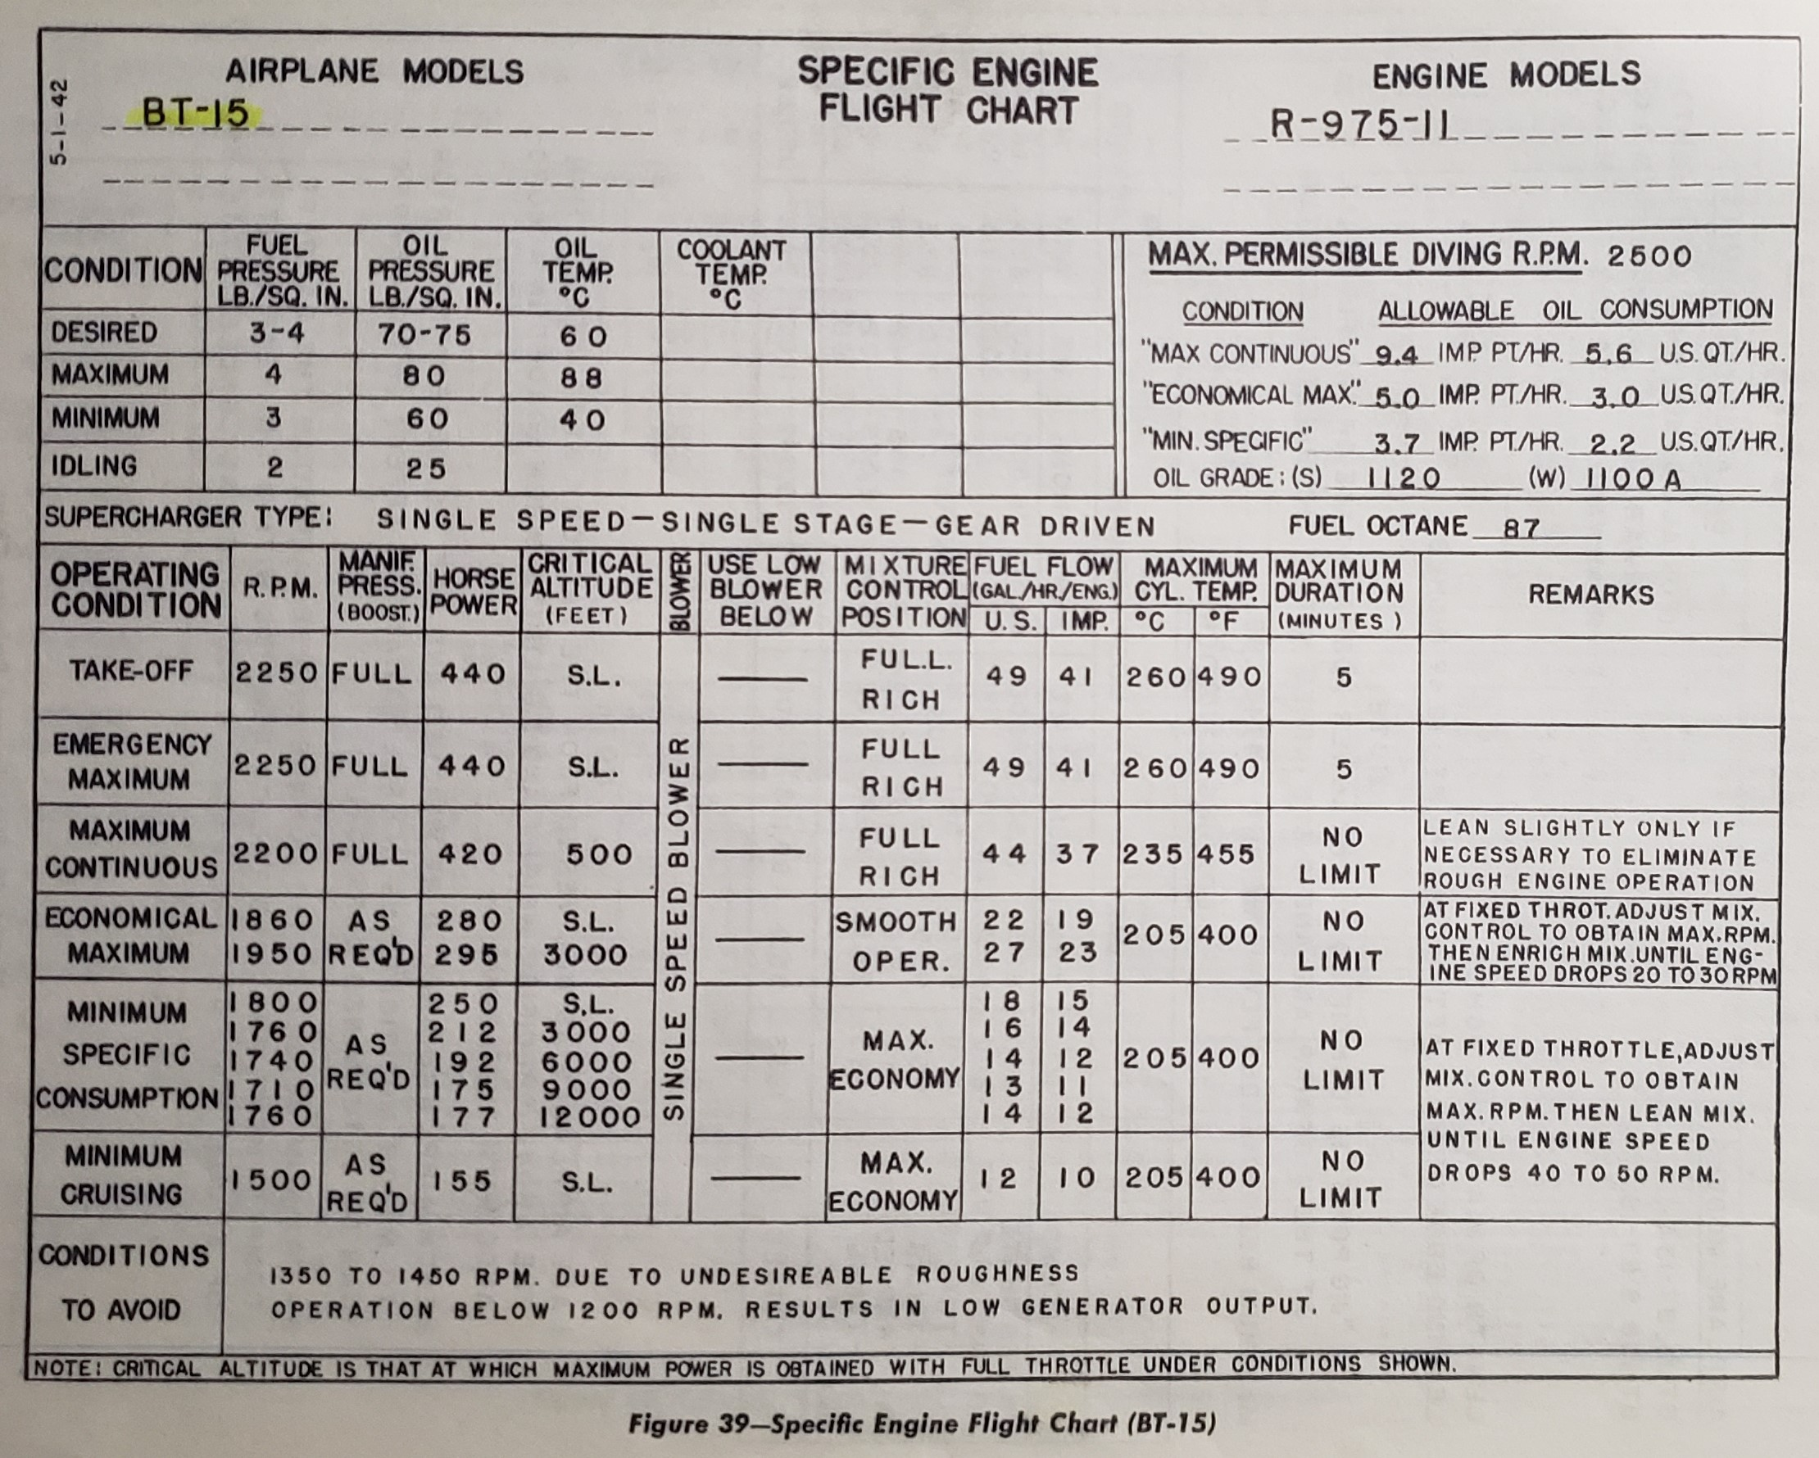
{ }
{ }

Slide 32
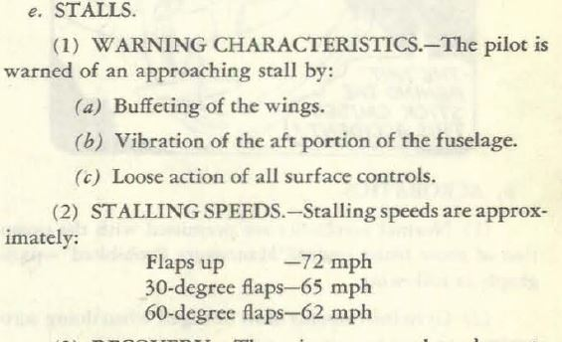
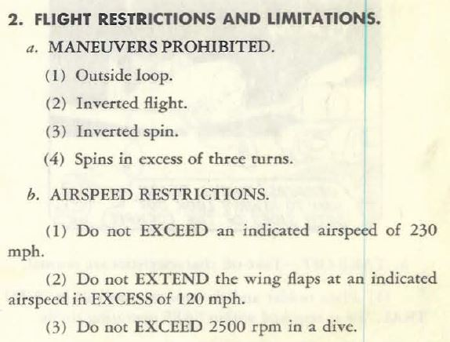

Slide 33
BT-15
System Questions
What is the normal ground run TO distance, 100F, at 500 MSL, with a 10 mph headwind?
What is the normal power setting for TO?
What is the minimum amount of oil?
What is the best glide speed?
What are the stall speeds?
720 feet
Full / 2250 rpm
~7 gallons (not listed)
90MPH
Vs0 72MPH, 30º flaps 65MPH, 60º flaps 62MPH
33

Slide 35
BT-13
System Questions
What is desired engine oil pressure in flight?
What is the desired engine oil temperature in flight?
What speed is Vne?
What is the maximum gross weight?
What is the maximum baggage weight?
70 to 75 PSI
50 to 70 Degrees C
207 MPH
4350 pounds
175 pounds
35

